Slide 1
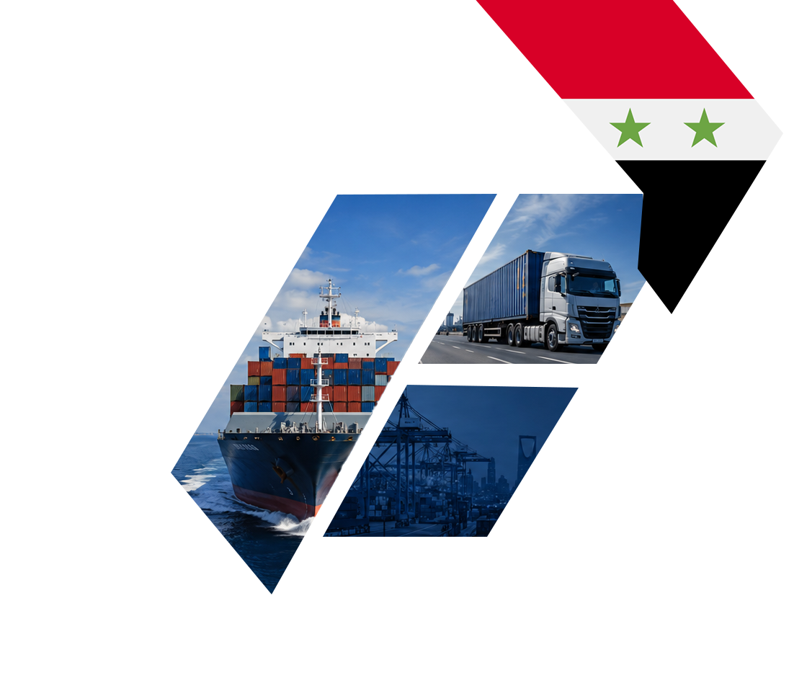
v
Guide for Syrian Companies Exporting to the Saudi Market
Regulatory and Customs Requirements and Product Registration Pathways
Content Review Date: August 2026
Edition: 2026

Slide 2
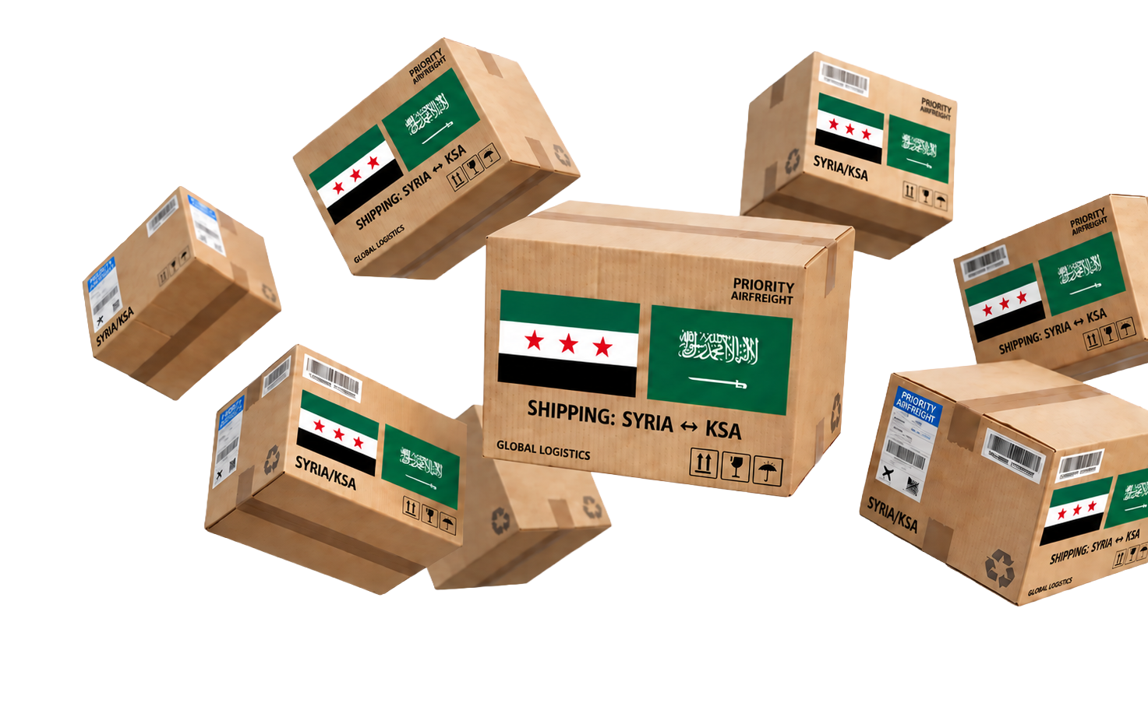
A product may require:
From Syria to the Saudi Market
Saudi Arabia represents one of the most important regional markets for Syrian products, thanks to its strong purchasing power, growing demand for agricultural, food, and industrial goods, and expanding trade relations between the two countries.
While the opportunities are significant, exporting Syrian products to Saudi Arabia requires full compliance with Saudi regulations, as requirements vary depending on the product category.
Registration with the Saudi Food and Drug Authority (SFDA)
Conformity Certificates issued through the SABER platform
Accredited laboratory test reports
Compliance with Saudi labeling requirements
Additional regulatory approvals for certain product categories
Proper technical and regulatory preparation before export is therefore essential for successful market entry.

Slide 3

Why the Saudi Market?
Saudi Arabia is one of the largest consumer and industrial markets in the Middle East, offering extensive opportunities for Syrian exporters across multiple sectors.
Its key advantages include:
The largest economy in the Arab world
More than 36 million consumers
High purchasing power
Mega projects under Saudi Vision 2030
Continuous industrial and commercial expansion
A modern investment environment that supports high-quality products

Slide 4

Kingdom of Saudi Arabia
Gulf Cooperation Council
Tabseer... Your Gateway to the Saudi and GCC Markets
Product registration on the SABER platform.
Issuance of Product Conformity Certificates (PCoC).
Issuance of Shipment Conformity Certificates (SCoC).
Obtaining the Saudi Quality Mark (SQM).
Issuance of Saudi Food and Drug Authority (SFDA) certificates.
Registration of food and cosmetic products through the Ghad platform.
Certification of lifting equipment.
Obtaining the Oxo-Biodegradable Plastics Logo.
Issuance of the Gulf Conformity Mark (G-Mark).
Sultanate of Oman
Obtaining the Omani Quality Mark.
Arab Republic of Egypt
Tabseer provides comprehensive conformity assessment and technical compliance solutions, helping companies meet Saudi and GCC regulatory requirements and accelerate market access.
Issuance of inspection and verification certificates.
Carbon footprint calculation services.

Slide 5
Syrian Chambers of Commerce and Industry
Key Authorities Throughout the Export Journey
Responsible for issuing:
Certificates of Origin
Commercial attestations
Various export-related documents
Export Development and Local Production Support Authority
Syrian Authorities
Provides exporter support programs, promotes Syrian exports, facilitates participation in international exhibitions, and supports market expansion initiatives.
General Authority for Land and Sea Ports (and the Competent Customs Authorities)
Responsible for customs clearance procedures, export processing, verification of export documentation, and issuance of customs declarations.

Slide 6

Certificate of Origin
Shipment Conformity Certificate (SCoC)
The Certificate of Origin is one of the primary documents required to verify the country of manufacture of Syrian products exported to Saudi Arabia.
It is typically issued by:
Syrian Chambers of Commerce
Or another authorized issuing authority
The information on the certificate must match:
Commercial invoice
Packing list
Customs declaration
Product details
After obtaining the PCoC, a Shipment Certificate of Conformity must be issued for each shipment exported to Saudi Arabia. This certificate is required for customs clearance.
Before Shipping, Make Sure You Have:
Registered the product on SABER
Obtained a Product Certificate of Conformity, where required
Obtained a Shipment Certificate of Conformity for every shipment
Verified the correct HS Code
Ensured consistency across all product documentation
Confirmed that labels comply with Saudi requirements
Second: Saudi Authorities
Industrial and Consumer Products (SASO & SABER Pathway)
Product Conformity Certificate (PCoC)
Saudi Standards, Metrology and Quality Organization (SASO)
SABER Electronic Platform
Saudi Food and Drug Authority (SFDA)
Zakat, Tax and Customs Authority (ZATCA)
A Product Certificate of Conformity is issued for regulated products after reviewing the technical file and verifying compliance with the applicable Saudi Technical Regulation through an approved Conformity Assessment Body.
Many industrial and consumer products exported to Saudi Arabia are subject to Saudi technical regulations issued by SASO and processed through the SABER electronic platform.
The compliance process begins by determining whether the product is:
Subject to a Saudi Technical Regulation
Not subject to any Technical Regulation
Eligible for Supplier's Declaration of Conformity (Self-Declaration)
Required to undergo assessment by an approved Conformity Assessment Body

Slide 7
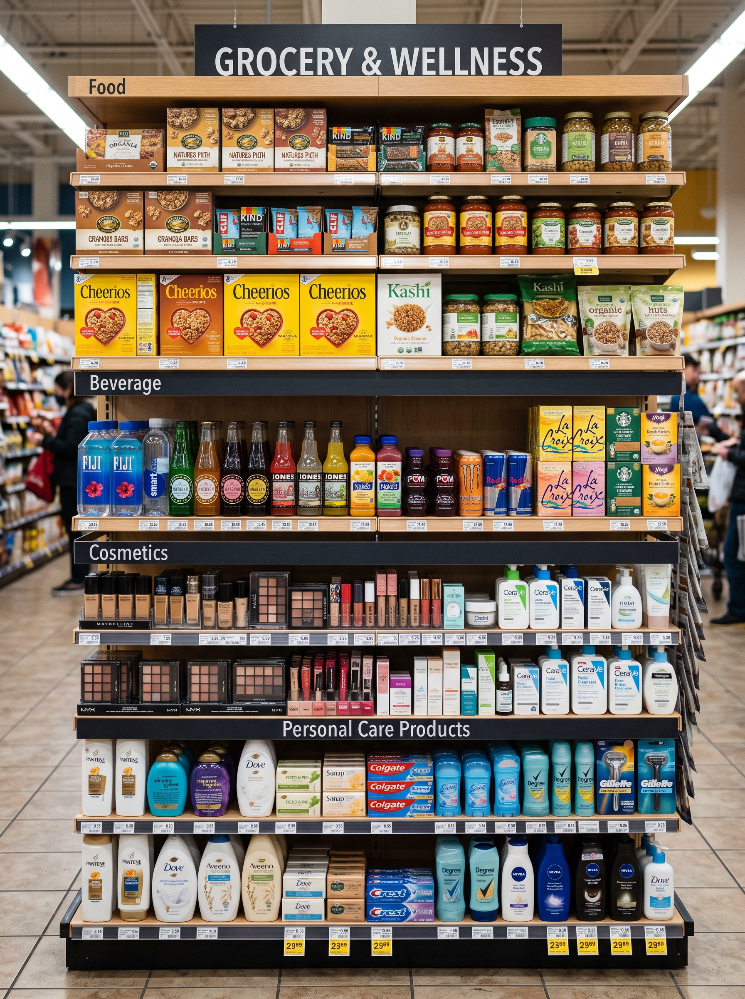
Before Export
The Syrian manufacturer or exporter should coordinate with a licensed Saudi importer registered with the SFDA, as the importer is responsible for product registration and regulatory notifications.
Food Labeling
Food labels must comply with Saudi and GCC regulations and include mandatory information in Arabic, including:
Product name
List of ingredients
Country of origin
Net weight or volume
Production and expiry dates
Manufacturer and importer details
Storage and usage instructions, where applicable
Food, Beverages, Cosmetics, and Personal Care Products
Food products, beverages, cosmetics, animal feed, and health products fall under the supervision of the Saudi Food and Drug Authority (SFDA), with compliance requirements varying by product category.

Slide 8
Food Products | SFDA registration, depending on product type
Cosmetics | Registration through the GHAD system
Electrical Products | SABER registration and conformity certificates
Children Toys | G-Mark, where applicable
Plastic Products | SABER or Oxo-Biodegradable Plastics Logo, where applicable
Detergents | SFDA or SABER requirements, depending on classification
Apparel and Textiles | SABER, where covered by applicable Technical Regulations
Pathways for Selected Key Sectors

Slide 9
Shipping products before obtaining the required certificates
Using an incorrect HS Code
Inconsistent information across documents
Non-compliant Arabic labels
Relying solely on foreign certificates
Working with an unqualified Saudi importer
Most Common Export Mistakes

Slide 10

Identified the correct HS Code
Determined the responsible Saudi regulatory authority
Verified whether the product is subject to Saudi Technical Regulations
Prepared a complete technical file
Obtained the required laboratory test reports
Reviewed Arabic labeling requirements
Obtained the Certificate of Origin
Secured the Product or Shipment Certificate of Conformity where applicable
Verified the commercial invoice and packing list details
Coordinated in advance with a qualified Saudi importer
Pre-Export Checklist
Before exporting any product from Syria to Saudi Arabia, ensure that you have:

Slide 11
Legal Disclaimer
This guide has been prepared for general awareness and informational purposes only and does not constitute prior approval for any product or shipment.
Applicable requirements may vary depending on the product type, HS Code, responsible regulatory authority, and the latest updates issued by the Saudi authorities.
Accordingly, each product should undergo an independent technical assessment before production, export, or shipment.

Slide 12
Contact Information
We help companies successfully access the Saudi market through integrated technical compliance solutions, conformity certification management, and seamless coordination with the relevant regulatory authorities.
Support@tabseergroup.com
www.tabseer.co
+966920010756

